Slide 1
4Disciplines of Execution RLF Reconnect Presentation 14 April 2012

Slide 2
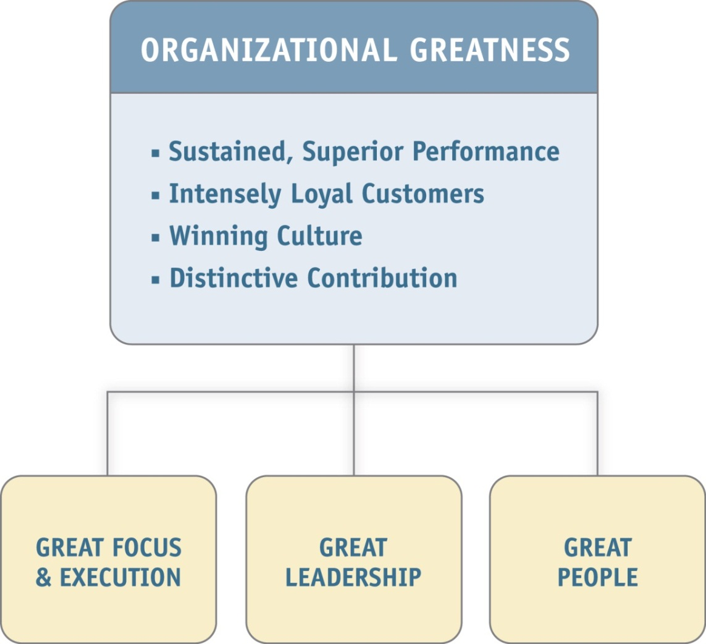
Organizational Greatness

Slide 3
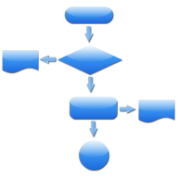
Where Do Results Come From?
RESULTS
Strategy
Process
Execution

Slide 4
Video
Goal!

Slide 5
What is Execution?
The discipline of getting the most important things done.

Slide 6
What Causes Execution to Break Down?
"The greatest unaddressed issue in the business world today is the 'execution gap' – the gap between setting a goal and achieving it."
- Ram Charan

Slide 7
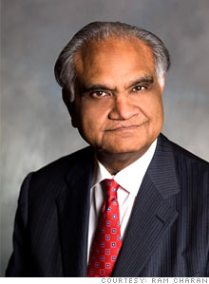
Setting the Context What causes organizational and strategic failure?
“It’s bad execution. As simple as that: not getting things done, being indecisive, not delivering on commitments.”
“Seventy percent of strategic failures are due to poor execution…it’s rarely for lack of smarts or vision.”
Ram Charan, Co-author of Execution: The Discipline of Getting Things Done

Slide 8
Execution
“Execution is the major job of a leader and must be the core element of an organization's culture.”
Ram Charan, Co-author of Execution: The Discipline of Getting Things Done

Slide 9
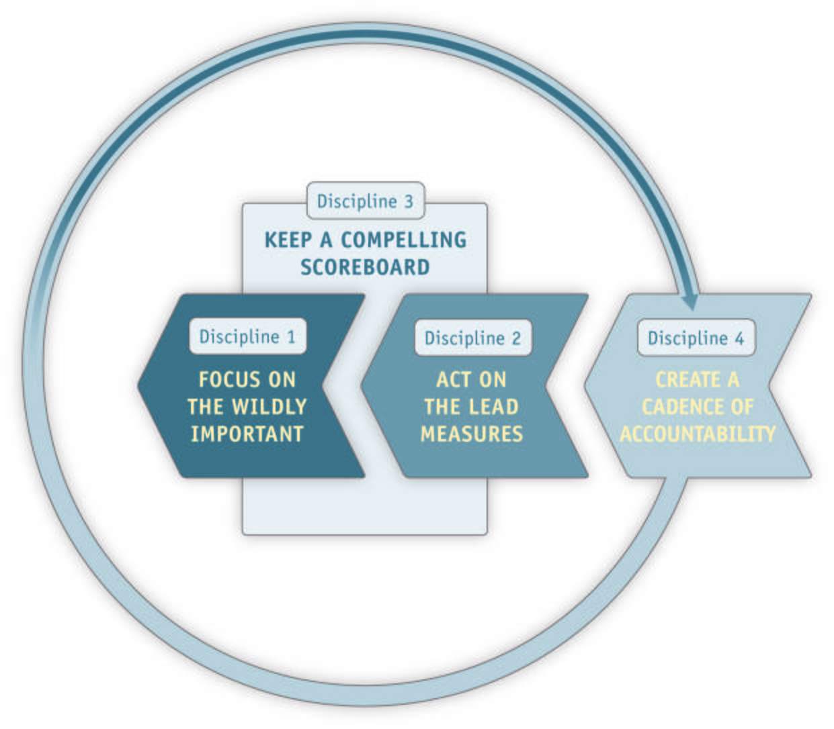
The Process FrankinCovey's 4 Disciplines of Execution

Slide 10
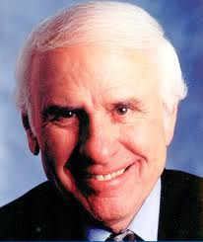
Freedom of Discipline
“We must all suffer from one of two pains: the pain of discipline or the pain of regret.”
Jim Rohn, business philosopher and consultant

Slide 11
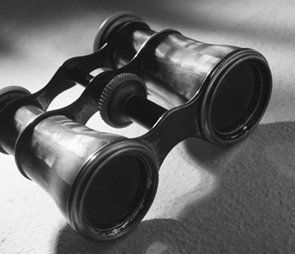
Discipline 1 - Focus on the Wildly Important
The Enemy of the Great is the Good!

Slide 12
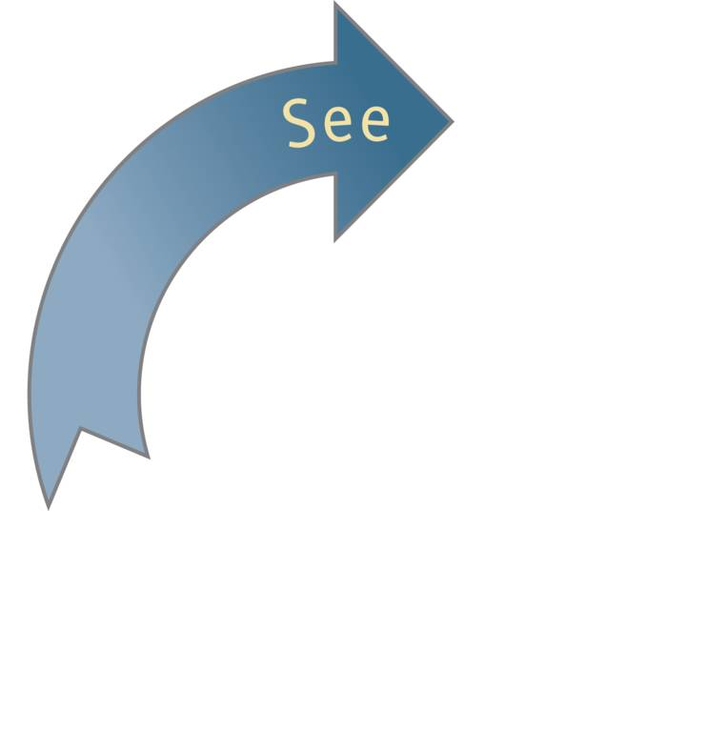
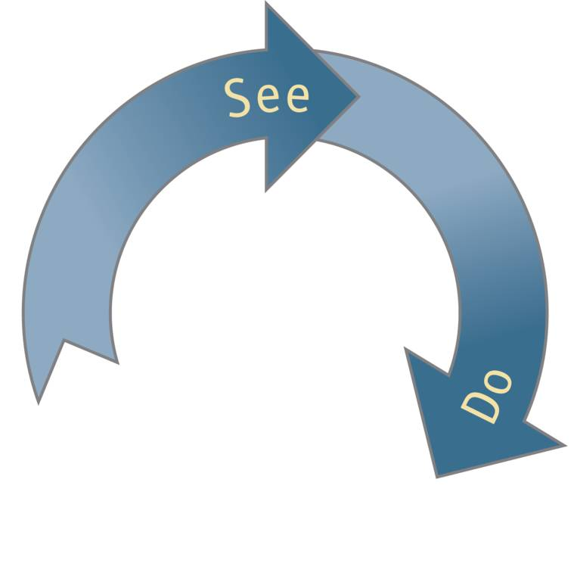
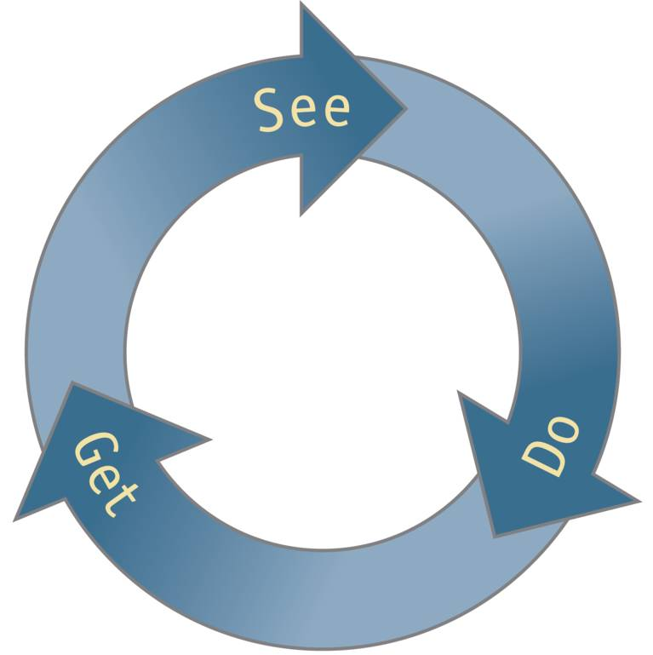
How we See the world. . .
which, in turn, creates the results we Get.
determines what we Do. . .

Slide 13
OLD THINKING:
We can effectively accomplish 6, 8, or even 10 important goals at once.
NEW THINKING:
We can accomplish only 1, 2, or 3 important goals with excellence.
Define your Wildly Important Goals.
Define the lag measures for your WIGs.
Laser focus on your top priorities.

Slide 14
Video
Land One at a Time

Slide 15
Wildly Important Goals (WIGs)
What is an important goal?
A goal with significant consequence and value.
What is a Wildly Important Goal?
A goal that makes all the difference. Failure to achieve this goal renders any other achievements inconsequential.
Called a Lag Measure

Slide 16
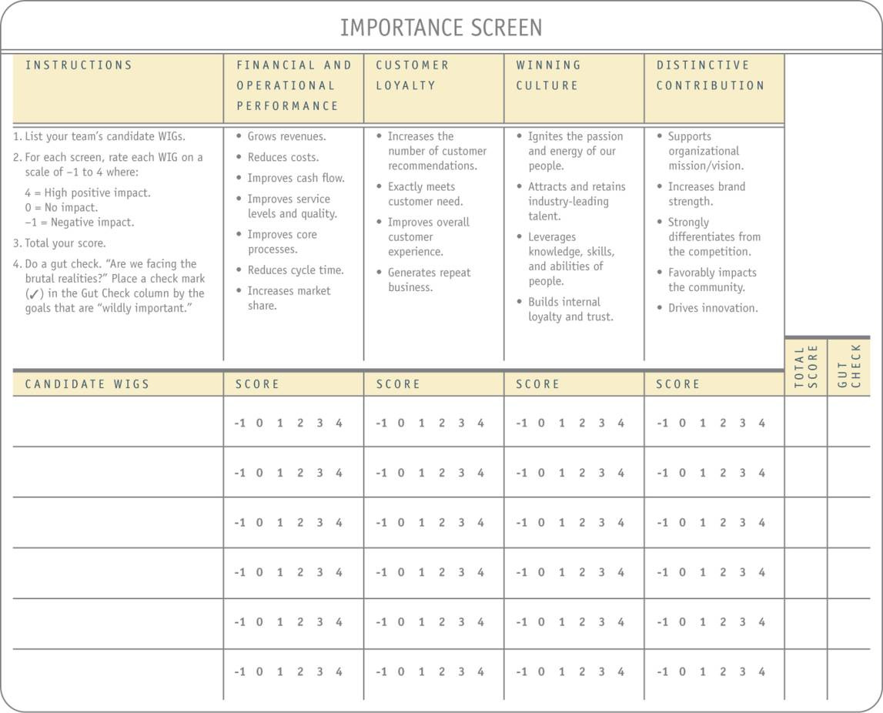
Individual and Group Exercise
As a group, brainstorm a list of candidate WIGs for your team.
Run these through the importance sheet, rating each goal on a scale of -1 to 4.
Total the scores.
Do a gut check and choose candidate WIGs.

Slide 17
What is a Lag Measure?
A lag measure tells you if you have achieved your goal.
From X to Y by When
A lag measure consists of:
Performance gap: from X to Y
Gap-closure timeframe: by When

Slide 18
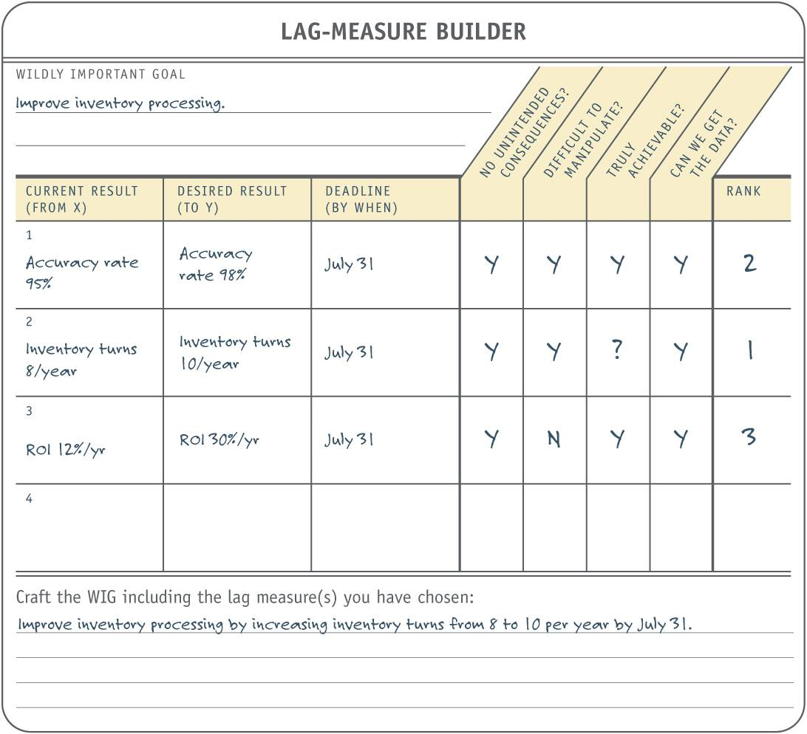
Individual and Group Exercise
Brainstorm your top 3 personal, operational or leadership goals.
Fill out the lag-measure builder for each.
Determine measure ranks.
We will discuss this as a group and you can then choose your WIG(s).

Slide 19
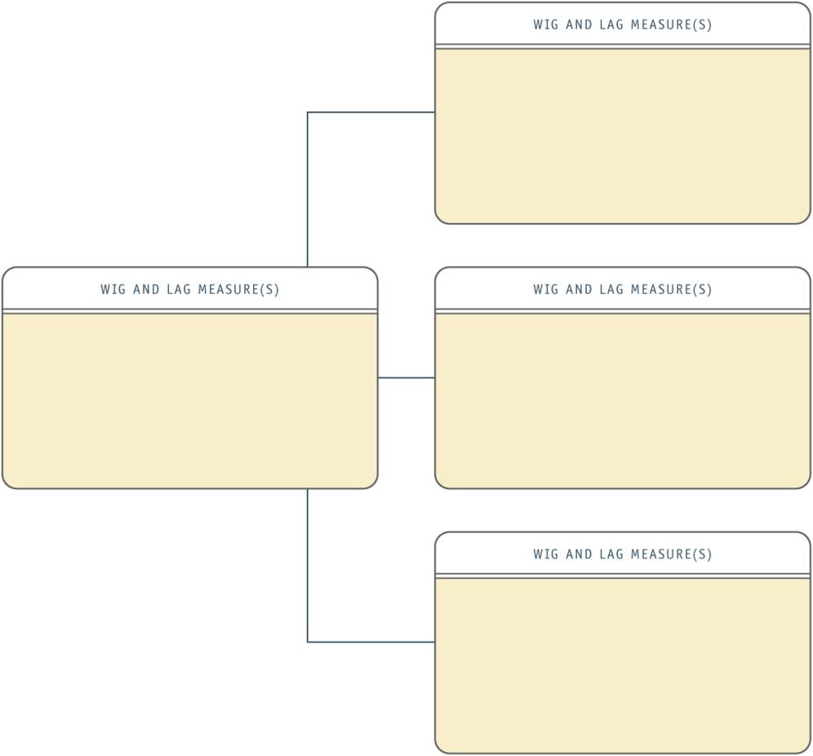
Individual and Group Exercise (cont.)
Once your WIGs have prioritized Lags associated with them, fill out the WIG flowchart for each.
In the left-hand box, insert the appropriate WIG.
In the right-hand boxes, insert any supporting WIGs and lag measures.

Slide 20
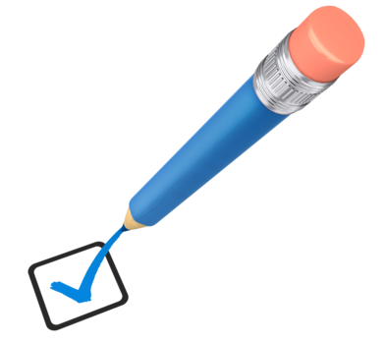
Gut Check
What would it mean to me if I achieved these WIGs?
How committed am I in achieving these WIGs?

Slide 21
Discipline 2 - Act on the Lead Measures
80% of results come from 20% of activities

Slide 22
OLD THINKING:
Watch the lag measures and work hard to achieve the WIGs.
NEW THINKING:
Act on the lead measures as the best predictors of achieving the WIGs.
Analyze and identify the 80/20 activities.
Build lead measures that are predictive and influenceable.
Clear understanding of what to do to achieve your WIGs.

Slide 23
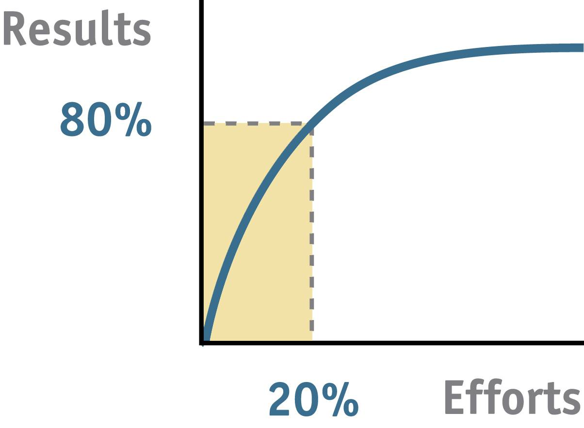
The 80/20 Rule

Slide 24
Analyze and Identify the 80/20 Activities
BARRIERS
What obstacles could hinder us from achieving the WIG?
POCKETS OF EXCELLENCE
What do the best performers do differently?
BRILLIANT & CREATIVE
What haven’t we thought of that could make all the difference?

Slide 25
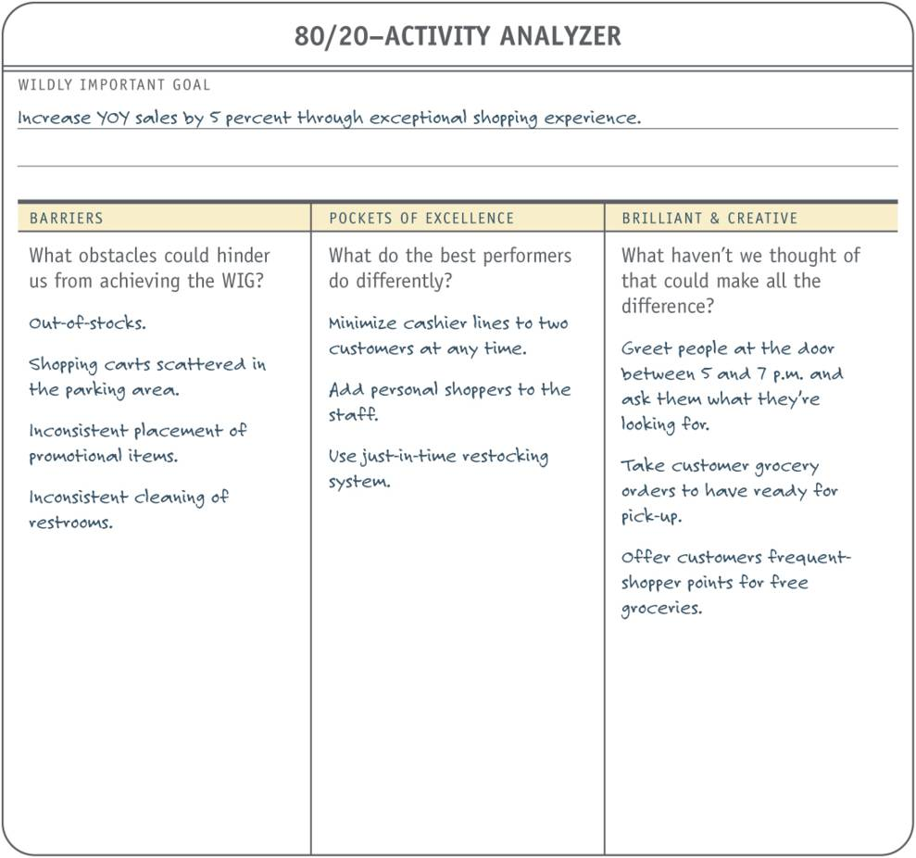
Individual and Group Activity
Insert the each WIG into the 80/20 Activity Analyzer.
Brainstorm under the appropriate headings.
Circle the one to three activities (overall) that will have the most impact on overcoming barriers and achieving the goal.

Slide 26
Video
Lead Measures

Slide 27
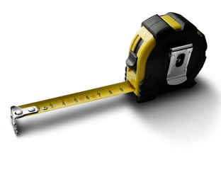
What is a Lead Measure?
The forecasted steps or “mini-goals” that define what we can do to assure we achieve our WIGs
Predictors of goal achievement
Vs. Lag Measures
Easier to influence
Harder to Measure

Slide 28
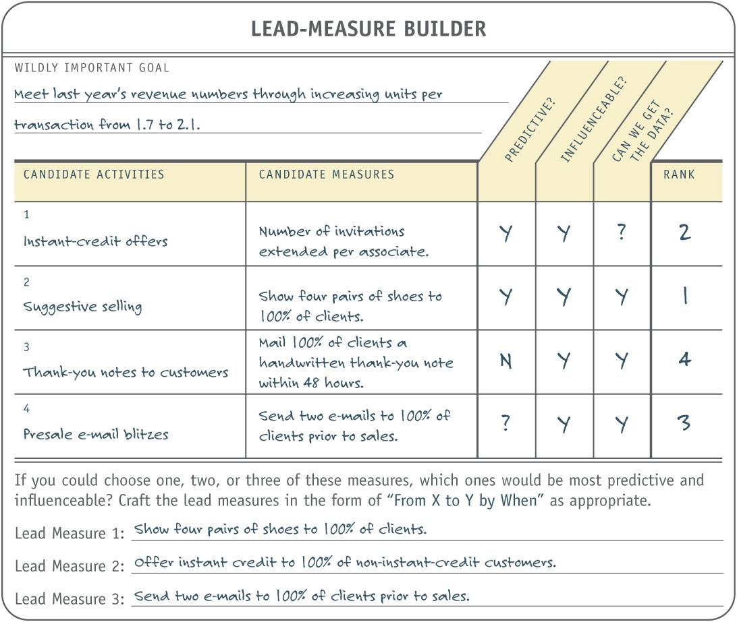
Individual and Group Exercise
Write down your 3 newly defined WIGs on the Lead-Measure Builder.
Fill out the Lead-Measure Builder for each.
Rank candidate activities in order of impact.
We will discuss this as a group and you can then choose your Leads(s).

Slide 29
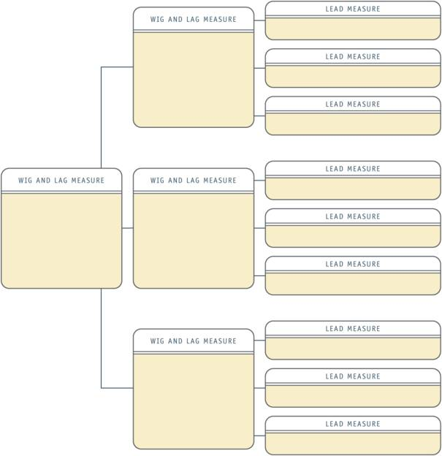
Individual and Group Exercise (cont.)
Insert your new Lead Measures (based on rank)for each WIG into the WIG flowchart using the boxes on the far right.

Slide 30
Gut Check
Are we completely convinced that these lead measures are the most predictive and influenceable of the goal?
How will this new understanding of lead measures affect how we operate day to day?

Slide 31
Discipline 3 – Keep a Compelling Scoreboard
People play differently when they’re keeping score

Slide 32
OLD THINKING:
Everybody knows how we’re doing on our goals.
NEW THINKING:
We’re only serious about our goals when we start keeping score.
Build a compelling team scoreboard.
Institute regular scoreboard updates.
High motivation and quick course correction.

Slide 33
Purpose of the Scoreboard
“The fundamental purpose of a scoreboard is to motivate the players to win.”
Jim Stuart

Slide 34
Video
The Dashboard

Slide 35
Rules for Scoreboards
Motivating. Can we tell if we are winning; that is, where we are and where we should be?
Simple. Can we tell within 5 seconds if we are winning?
Updateable. Can we update it easily?
Complete. Can we see both lead and lag measures?
Accessible. Can the whole team see it easily and often?

Slide 36
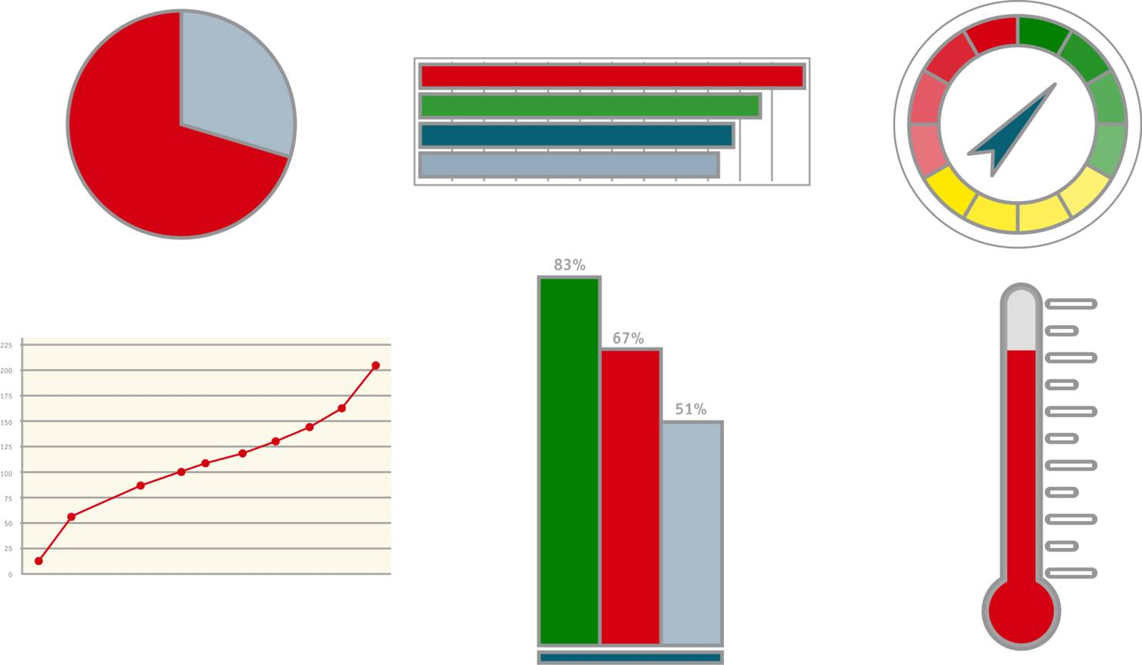
Scoreboard Choices

Slide 37
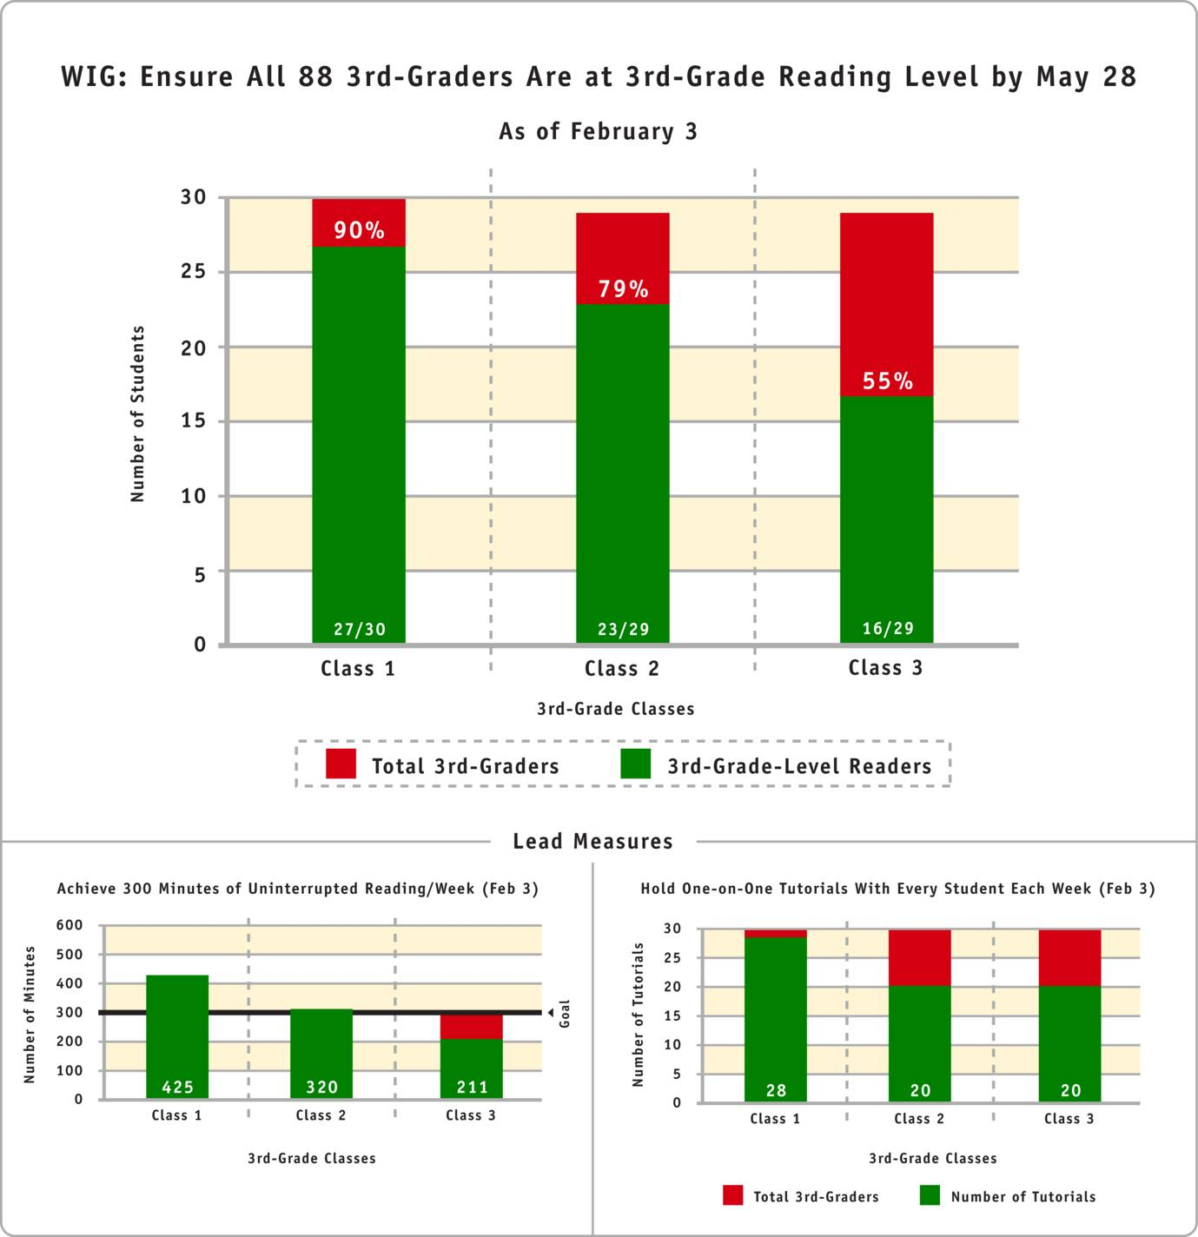
Procedure for Creating a Scoreboard
Gather the lead and lag measures.
Choose a scoreboard type.
Construct the scoreboard.
Evaluate the scoreboard.
Name the scoreboard and post it.

Slide 38
Gut Check
How will the scoreboard change the way we operate day to day?
Are we truly committed to keeping a compelling scoreboard?

Slide 39
Discipline 4 – Create a Cadence of Accountability
No accountability, no commitment.

Slide 40
OLD THINKING:
We execute!
NEW THINKING:
Execution falls apart without personal planning and team accountability.
Maximize the time spent on your WIGs.
Hold a weekly accountability session.
A high-performance, highly accountable work team.

Slide 41
Video
Store 334

Slide 42
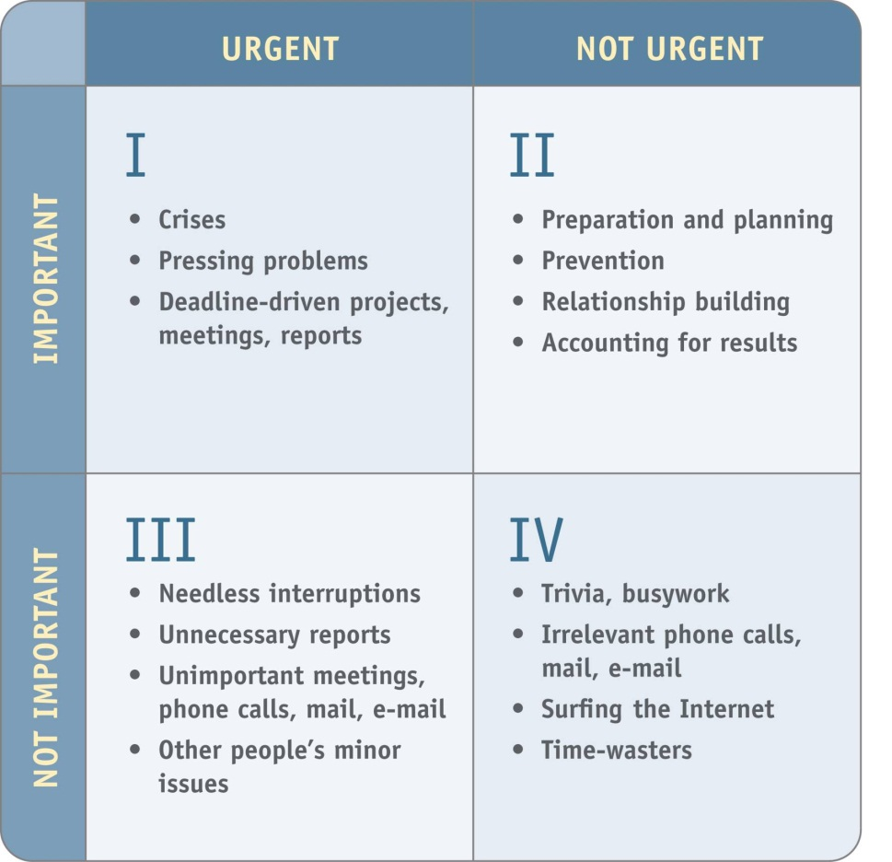
The Time Matrix

Slide 43
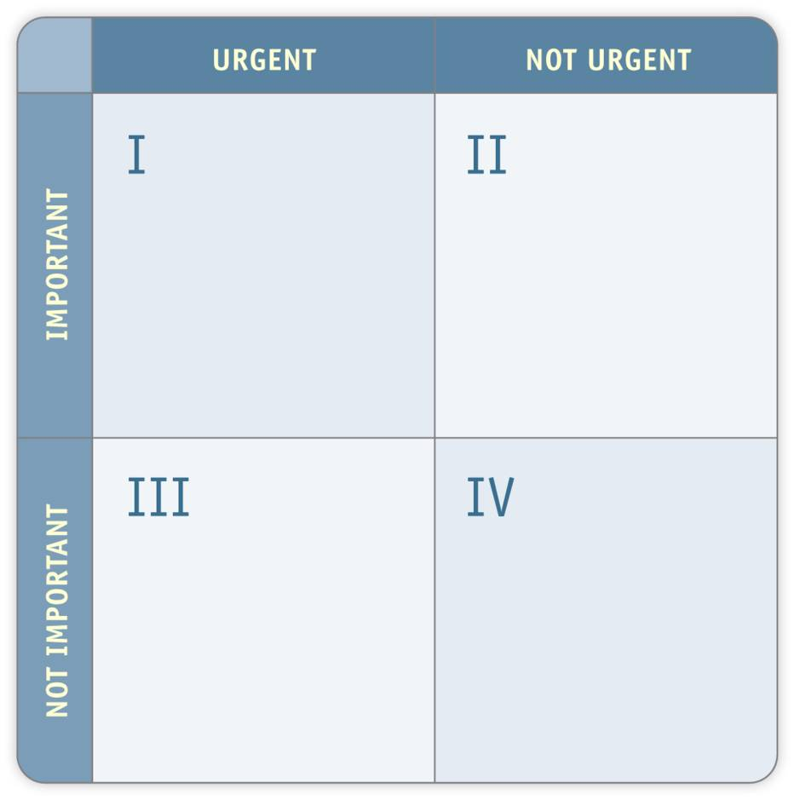
Individual and Group Activity
Write down all the activities that would fall in Quadrant III which might hinder you from achieving your WIGs.
In Quadrant II, write down those activities that you could do to escape from Quadrant III.

Slide 44
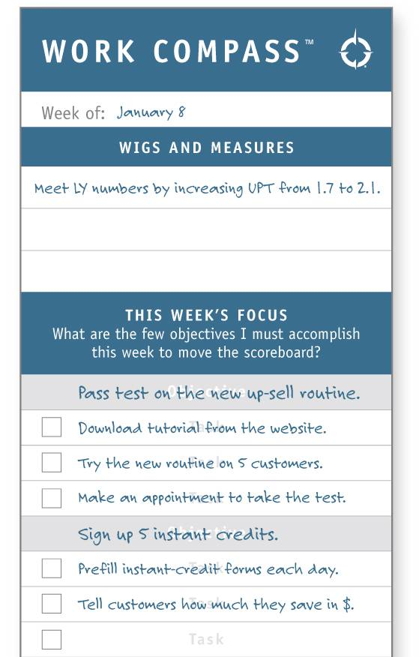
Individual and Group Activity (cont.)
Use the Work Compass to help determine the focus of your activities for the current week.
This will help you stay out of Quadrant III.
Note: Do this on a weekly basis to help hold yourself accountable for your actions.

Slide 45
Hold a Weekly Accountability Session (or "Cadence" Session)

Slide 46
Video
The WIG Session

Slide 47
Traditional Meetings vs. Cadence Meetings

Slide 48
WIG Progression
Define
Communicate
Refine

Slide 49
Final Gut Check
How will the Work Compass change the way I work individually?
How will the weekly WIG or Cadence Session change the way we operate as a team?
What is your level of commitment to…
The Work Compass?
The weekly WIG Session?

Slide 50
4DX Implementation at Grant Thornton
Started 4DX process in October of 2006
Created an Execution Team (E-Team)
Trained all levels of IT, including the SLT
Evolved process to directly tie strategy (firm and IT)
Built 4DX site to track process (scoreboard and cadence)
Challenged all teams (ITLC and teams within divisions to implement

Slide 51
Competencies Developed and Results Achieved
Competencies
Results
Strategic Thinking/Planning
Goal Development
Business Analysis
Personal/Team Productivity
Results Orientation
Accountability
Bias for Action
Teamwork
Communication
Team Problem Solving
Renewed Focus on Importance
Increased Customer Satisfaction
Visible Collaborative Boost in IT
Higher Level of Execution
Better Tracking of Results
Formation of the ITLC
Creation of the BTC

Slide 52
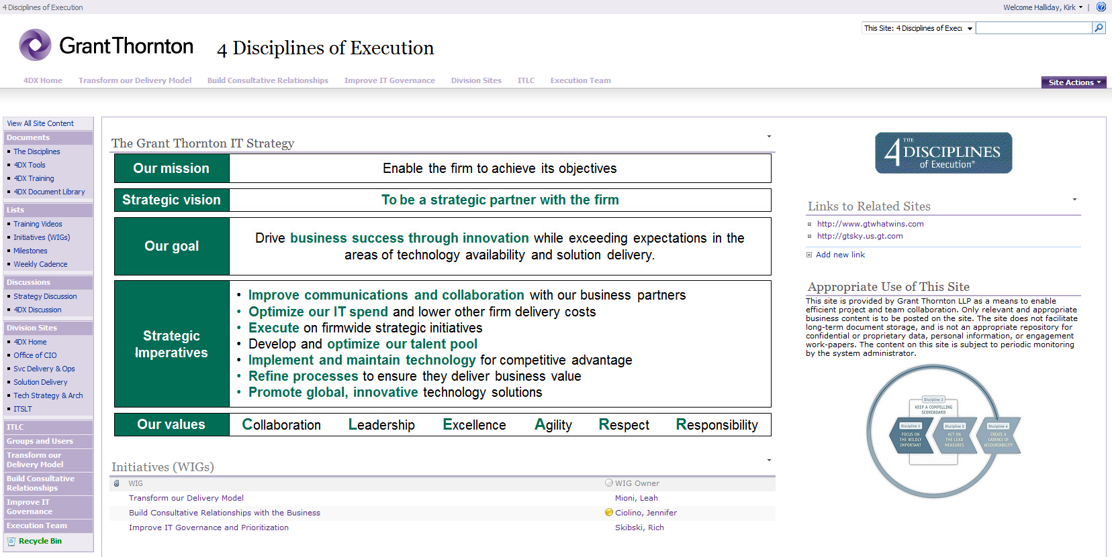
4 Disciplines of Execution Site Review SharePoint Site (URL: 4dx.us.gt.com)

Slide 53
Video
It Takes Everyone

Slide 54
Questions

